Slide 1
Stock Performance App
By: Thomas Ouyang

Slide 2
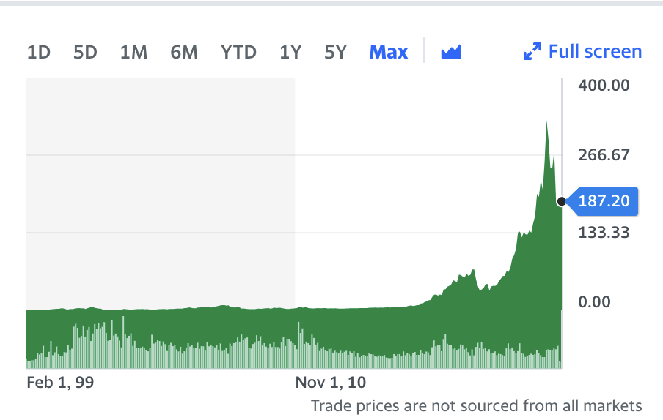
Introduction
Not much control over date range

Slide 3
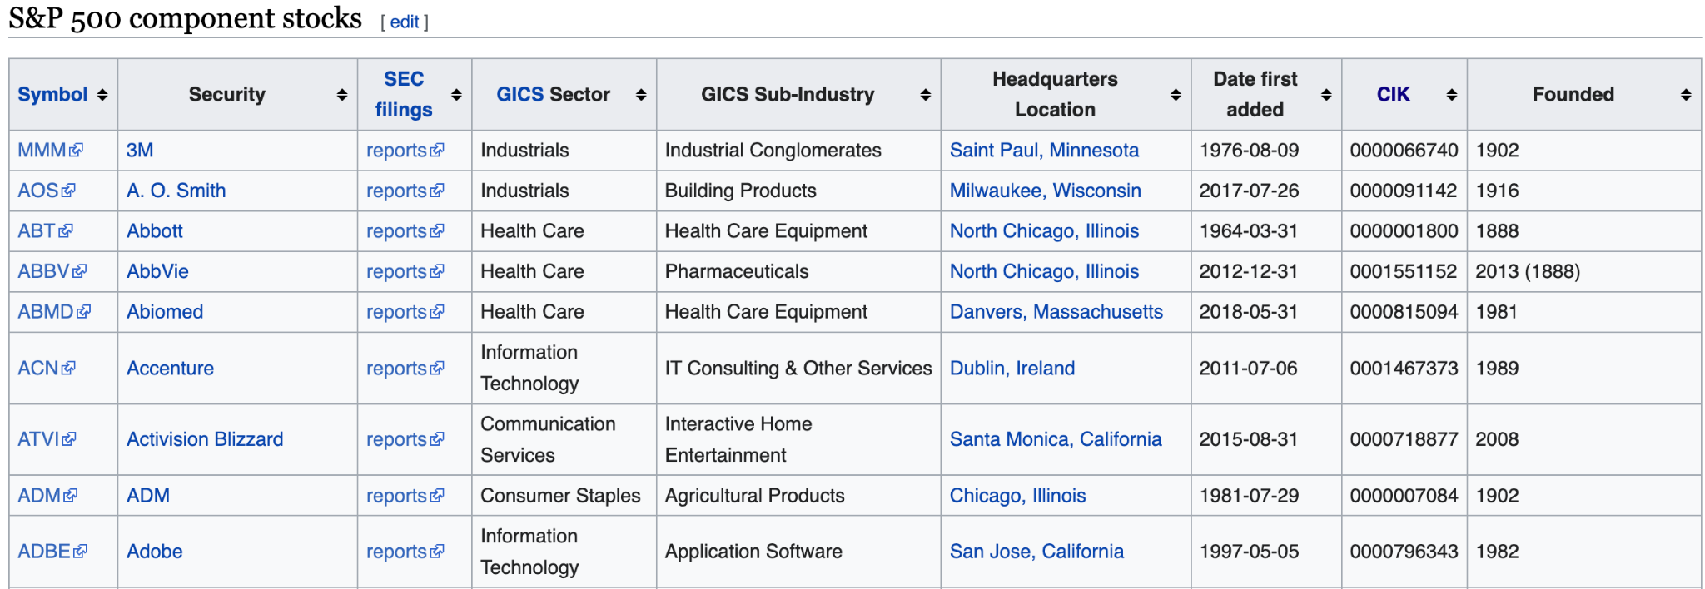
Data
Wikipedia and Yahoo Finance

Slide 4
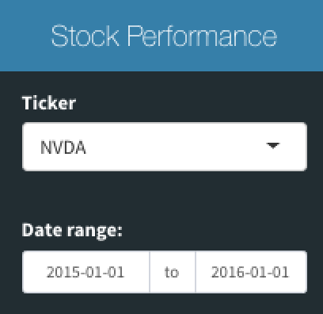
The App
Main Feature:
Allows user to interact with date
Choose Company Ticker Symbol amongst S&P500

Slide 5
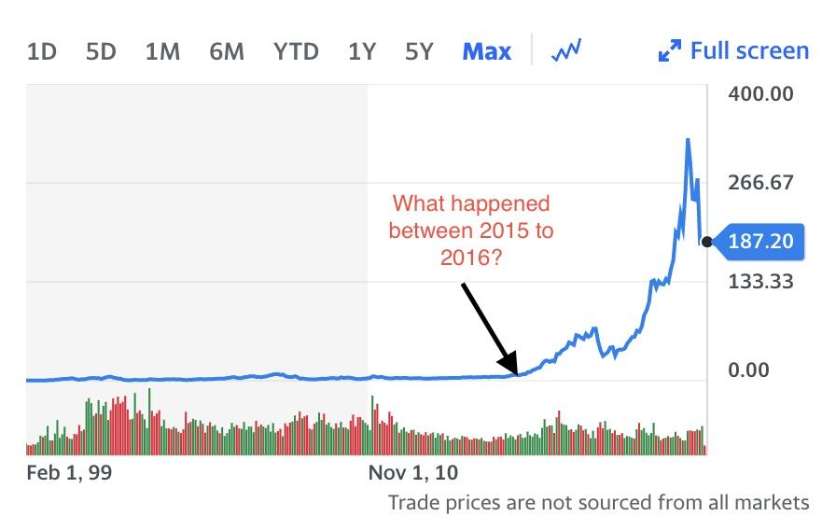
Example: Nvidia
NVDA’s stock Performance from 2015-2016
Free Charting Platform (Yahoo Finance)

Slide 6
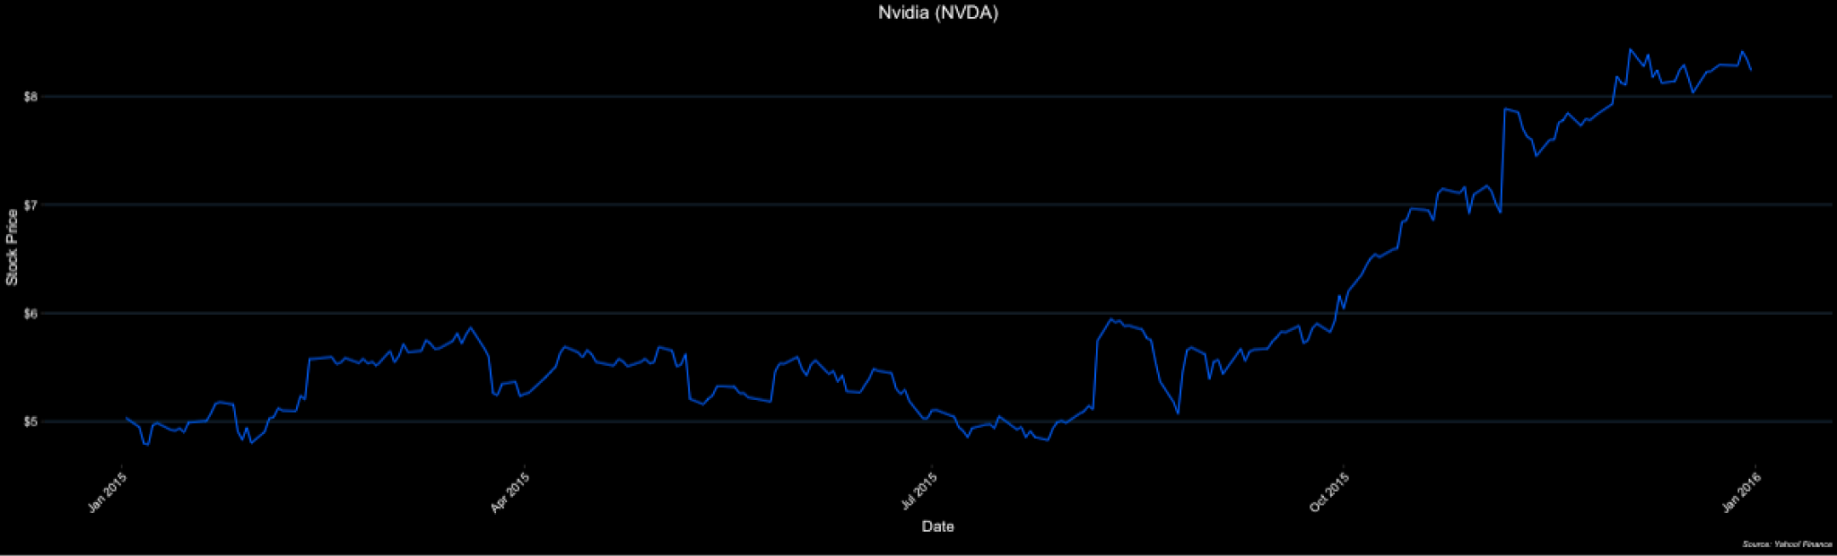
The App
More detailed Price Movement

Slide 7
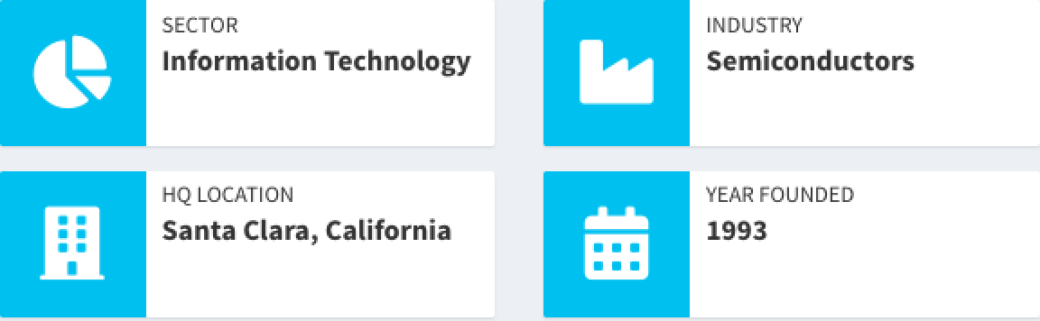
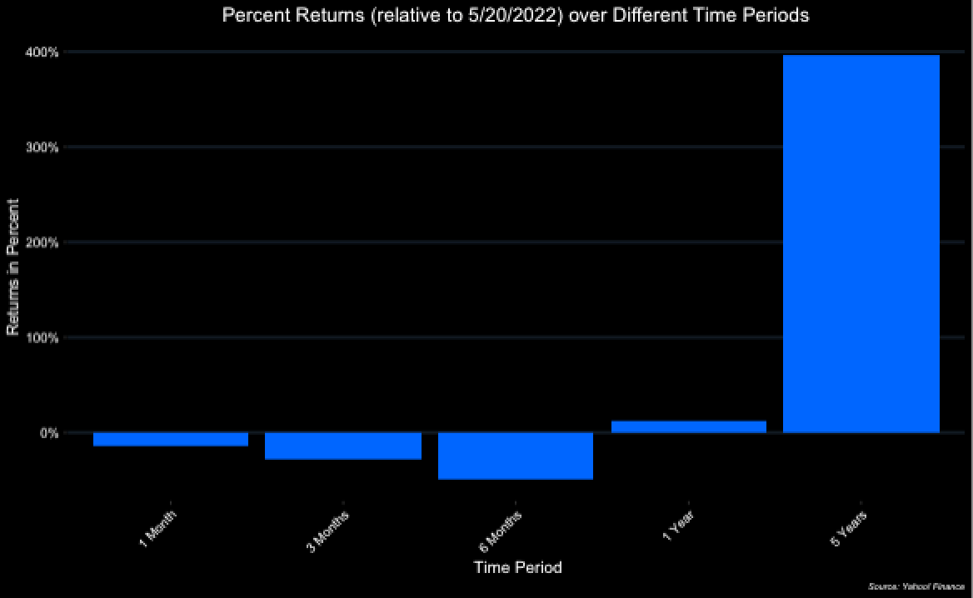
Other Features
Basic Information About Company:
Sector
Industry
HQ Location
Year Founded
Returns over Different Time Periods
(Relative to 05/20/2022)

Slide 8
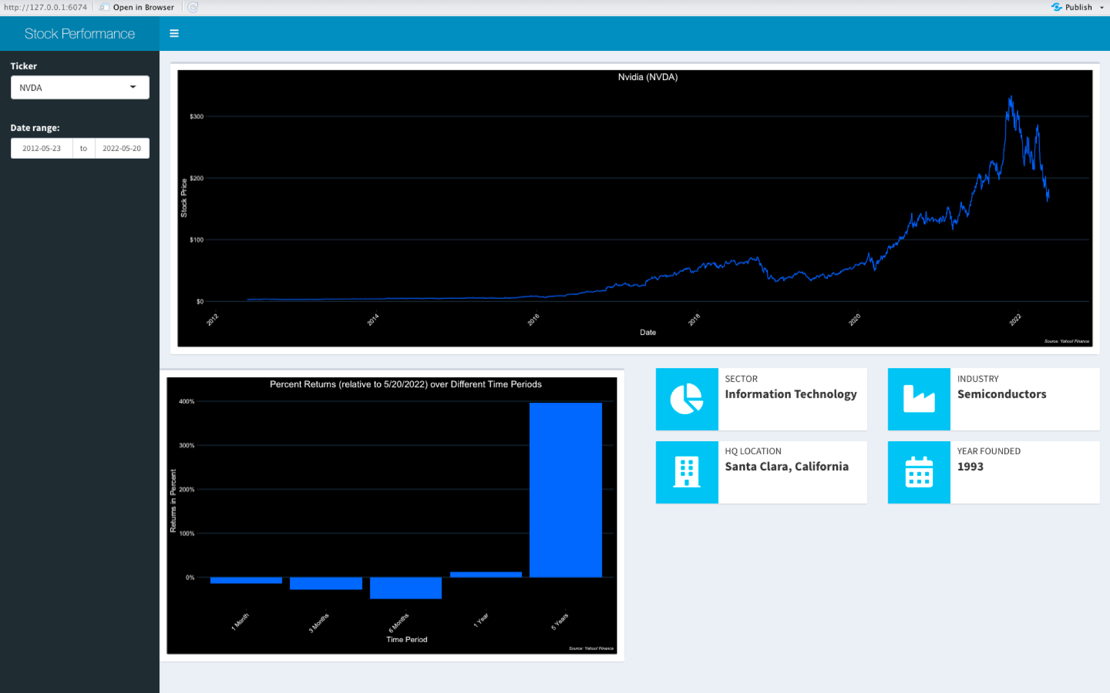
All Together

Slide 9
For the Future
Returns relative to end date user selected
Adding Financial Data about the Company (Like Revenue, Net Income, Debt, etc)
Company Comparisons
Overlaying Stock Price Performance (?)
Compare Financial Ratios
Difficult to acquire Financial Data

